Slide 1


PRESENTATION OUTLINE FOR GROUP D
ENSE 271 PROJECT
A COLLABORATION WITH SOUTH SASKATCHEWAN COMMUNITY FOUNDATION (SSCF)
Course Introduction
ENSE 271: ACTIVITY 4
April 08, 2025

Slide 2
PROJECT SPONSOR : DR TIM MACIAG ENSE 271 PROFESSOR
TEAM NAMES & MEMBERS:
GROUP D
Marc Aplaon
Maheen Siddique
Adai Yisah
Course Introduction
ENSE 271
April 08, 2025

Slide 3

PROJECT OVERVIEW
Objective:
Design a resource hub for charities to access information, resources, and learning opportunities.
Key Features:
Focus on fundraising, granting, operations, marketing, storytelling, and governance.
Tools Used:
Figma (high-fidelity prototypes).
StoriesOnBoard (User Story Map).
Powerpoint
wordpress

Slide 4
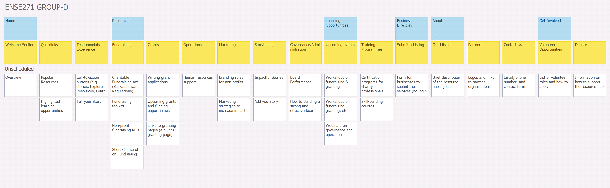
User Story Map (USM)

Slide 5
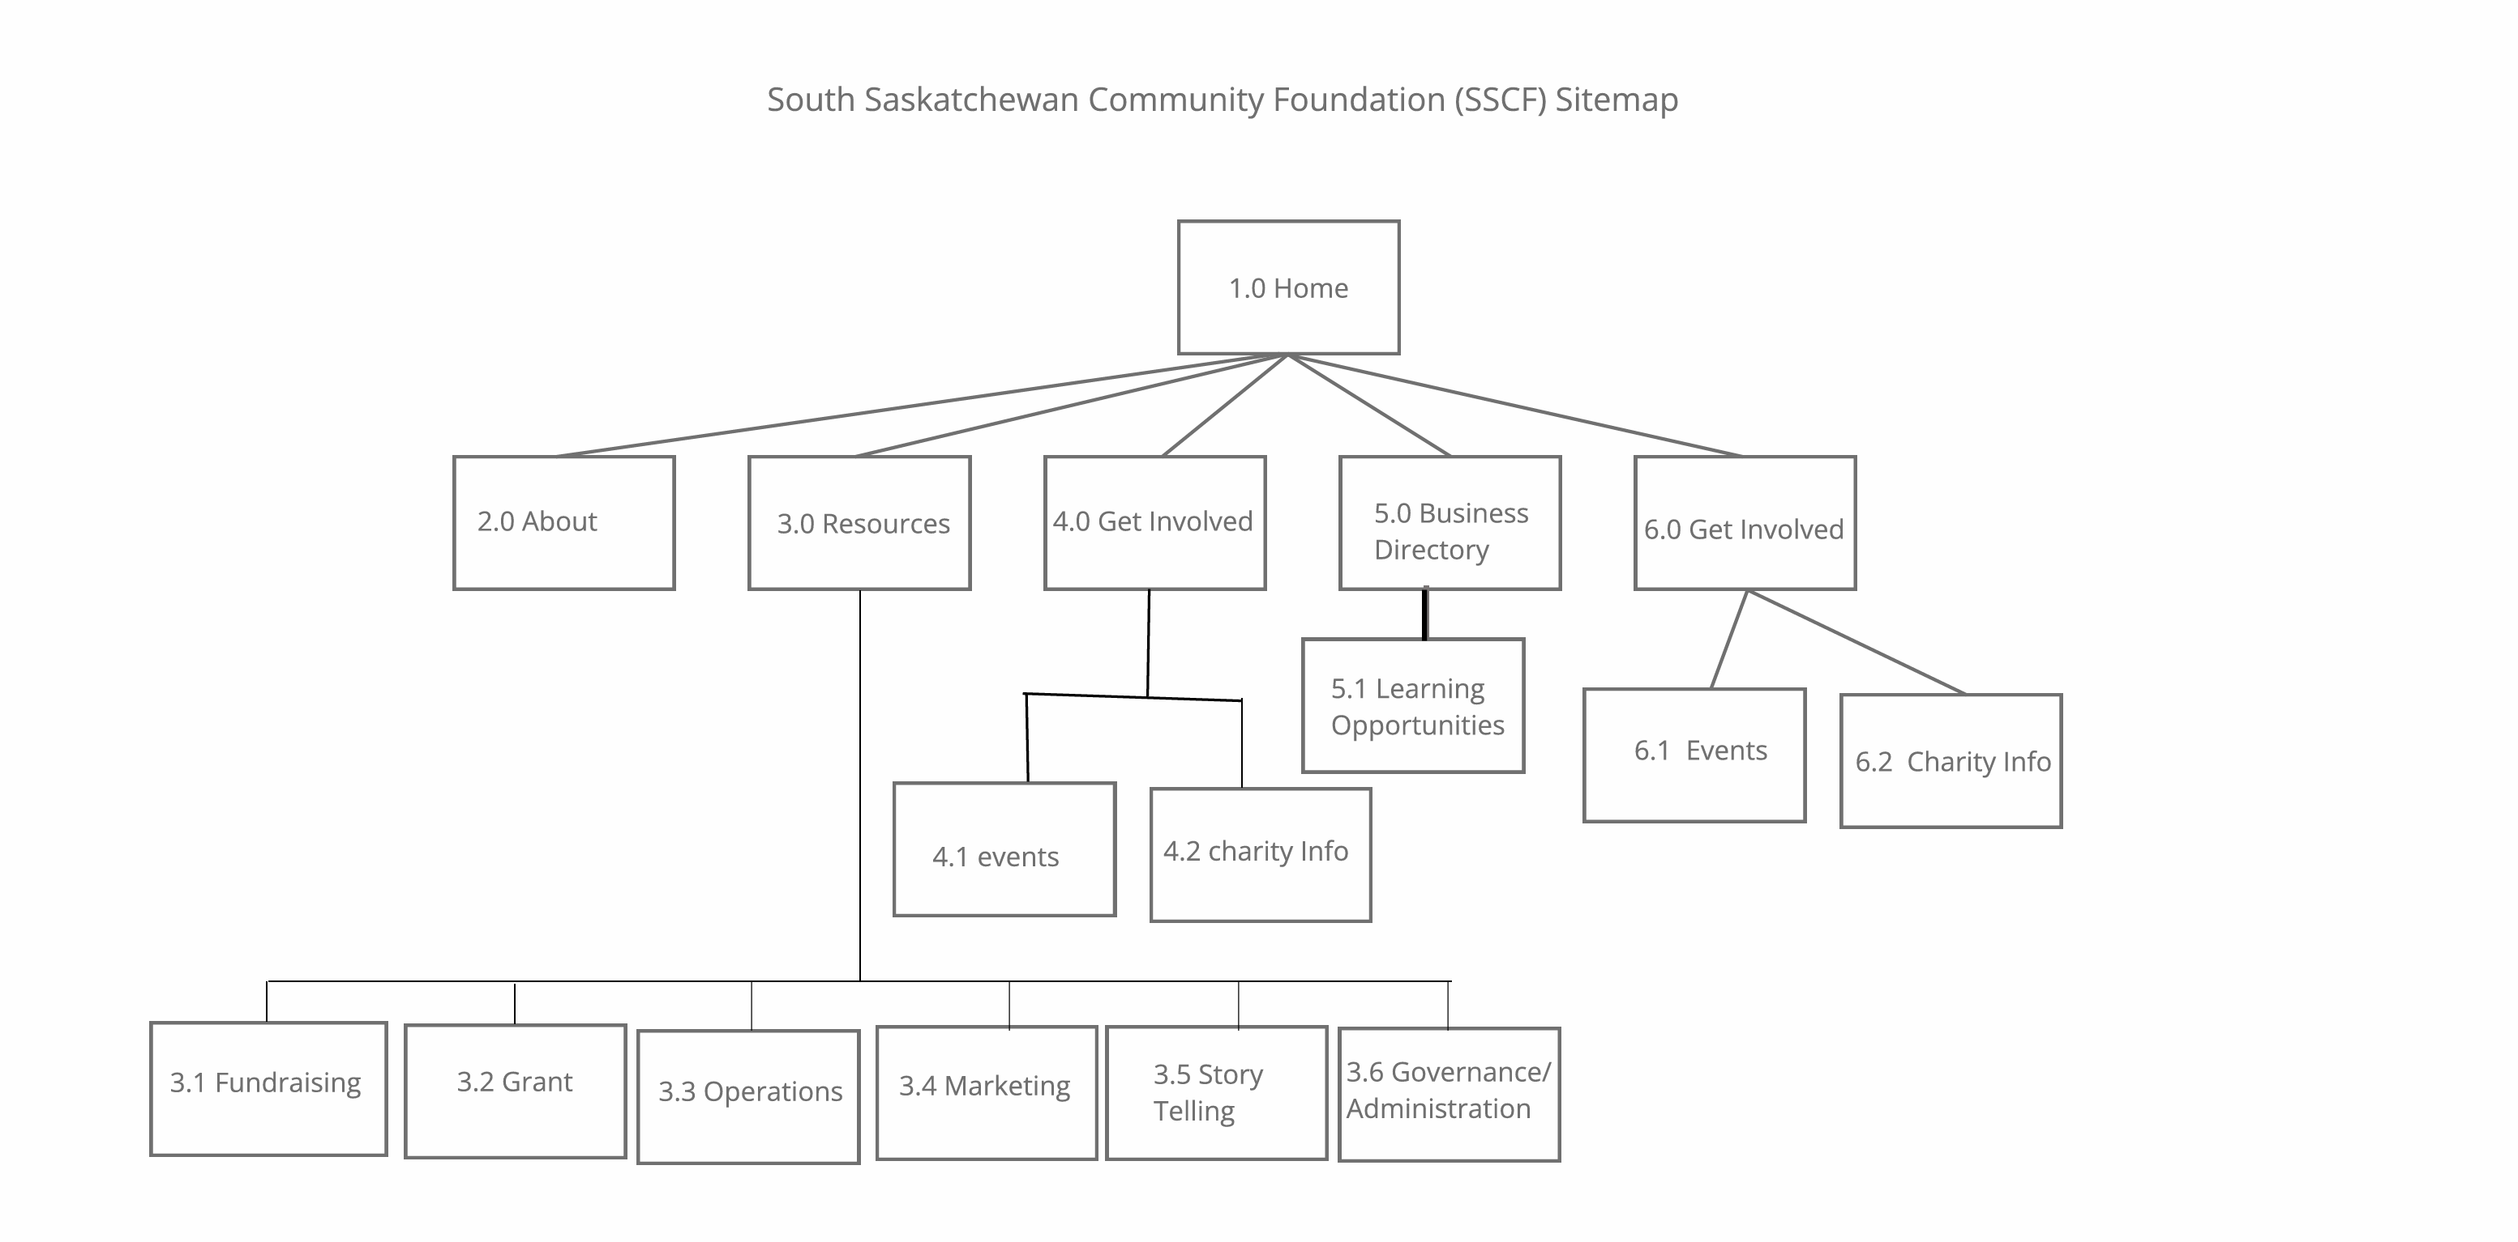

Slide 6
WordPress Demo Walkthrough
CONCEPTS
1. Affordances
2. Feedback
3. Signifiers
4. Fast Feed Back Cycle
5. Constraints

Slide 7
WORDPRESS THEME AND PLUGINS
NAME: - Astra WordPress
Attribute | Details
User Rating | 5,700+ five-star reviews
Last Updated | April 8, 2025
Active Installations | 1 million+
Key Purpose | Starter template and responsiveness
Why Chosen | Light weight and highly customizable and It offers special features and templates so it works perfectly with all page builders like Spectra, Elementor, Beaver Builder, etc. Fast performance, clean code, mobile-first design

Slide 8
WORDPRESS THEME AND PLUGINS
NAME: - Twenty-Twenty five
Attribute | Details
User Rating | 3.7 out of 5 stars
Last Updated | February 11, 2025
Active Installations | 800,000+
Key Purpose | Full site editing, typography and design tools
Why Chosen | Twenty Twenty-Five emphasizes simplicity and adaptability. It offers flexible design options, supported by a variety of patterns for different page types, such as services and landing pages, making it ideal for building personal blogs, professional portfolios, online magazines, or business websites.

Slide 9
Plugin List:
# | Plugin Name | Rating | Last Updated | Active Installs | Purpose & Key Features | Saskatchewan-Specific Use
1 | Akismet Anti-spam | 4.5 star (3,200+ ratings) | May 2024 | 5M+ | Blocks spam comments/form submissions using AI. Integrates with WPForms. | Protects charity contact forms from bot submissions.
2 | AMP | 4.3 star (1,800+ ratings) | Apr 2024 | 1M+ | Creates mobile-optimized pages with fast loading. | Improves rural access with low-bandwidth compatibility.
3 | Elementor | 4.8 star(12,000+ ratings) | Jun 2024 | 10M+ | Drag-and-drop page builder with 100+ widgets. | Used to design fundraising toolkit landing pages.
4 | Duplicate Page | 4.6 star (4,500+ ratings) | Mar 2024 | 800K+ | Clones pages/posts with one click. | Rapidly replicates grant application templates.
5 | Customizer Export/Import | 4.7star (1,200+ ratings) | Feb 2024 | 300K+ | Backs up and migrates theme customizations. | Preserves branding when transferring between dev stages.
6 | Smart Slider 3 | 4.8star (2,100+ ratings) | May 2024 | 900K+ | Creates responsive sliders/carousels. Supports videos. | Highlights success stories on homepage.
7 | Spectra | 4.9 star (5,700+ ratings) | Jun 2024 | 2M+ | Gutenberg blocks library with prebuilt templates. | Accelerates resource page layouts (e.g., toolkits grid).

Slide 10
Design Decisions
People-Centered Design Principles:
Affordances: Buttons look clickable, links are underlined.
Gestalt Principles: Grouped related items (e.g., Resources subcategories).
Constraints: Disabled non-clickable elements to guide users.

Slide 11
Key Excerpts:
"The Business Directory's location filter will be invaluable for rural charities." "Request: Add a 'Pro Bono' tag for free services." "Suggestion: Include a calendar sync for workshop reminders."
Notes:
For more information about this fund, please visit: https://sscf.ca/funds/anne-luke-legacy-fund/

Slide 12
CONCLUSION
Successes:
Rapid prototyping with Figma saved development hours
Challenges:
Content migration delays (resolved with CSV imports), upgrade on wordpress
Future Recommendations:
Home icon for navigation
Partner with SaskNonprofit for live grant alerts
Pro Bono Business Services

Slide 13
Q & A
Questions & Answers!
We welcome any questions or feedback!!!"

